Slide 1
Kruskal- Wallis H-test
B.SC CSIT 3rd Semester

Slide 2
Kruskal-Wallis H-Test:
Kruskal-Wallis H test popularly known as one-way ANOVA by rank is one of the most powerful non-parametric test. The testing mechanism is analogous to F-test of CRD (completely randomized design). This test, to some extent may be considered as an extension of median test and is recommended for comparing the several (k>2) independent populations.

Slide 3
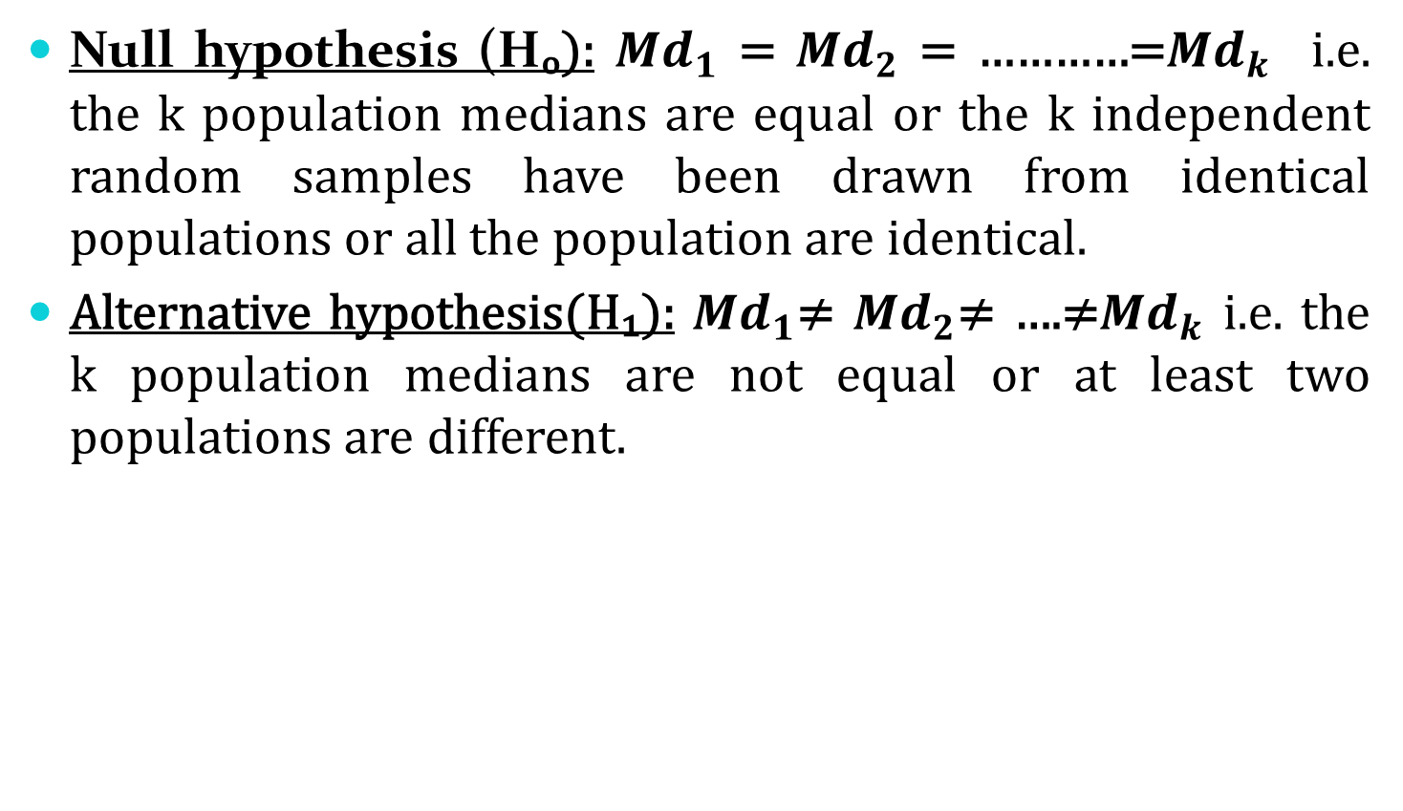
Problem to test:
Null hypothesis (Hₒ): ${Md}_{1}$ = ${Md}_{2}$ = …………=${Md}_{k}$ i.e. the k population medians are equal or the k independent random samples have been drawn from identical populations or all the population are identical.
Alternative hypothesis(H₁): ${Md}_{1}$≠ ${Md}_{2}$≠ ….≠${Md}_{k}$ i.e. the k population medians are not equal or at least two populations are different.

Slide 4

Test statistic:
$H_{cal}=\frac{12}{N\left(N+1\right)}(\frac{(\sum{R₁)²}}{n₁}+$ $\frac{(\sum{R₂)²}}{n₂} +….+\frac{(\sum{Rₖ)²}}{nₖ}$)$−3(N+1)$
Where, $n₁,n₂……nₖ$are the number in each of k samples,
$N=$ $n₁+n₂+…+nₖ$ and $R ₁ ,R₂ …….Rₖ$ are the ranks of each samples. The sampling distribution of H is a chi-square distribution with k-1 degree of freedom, provided that $n₁,n₂……..nₖ$are all at least 5.

Slide 5
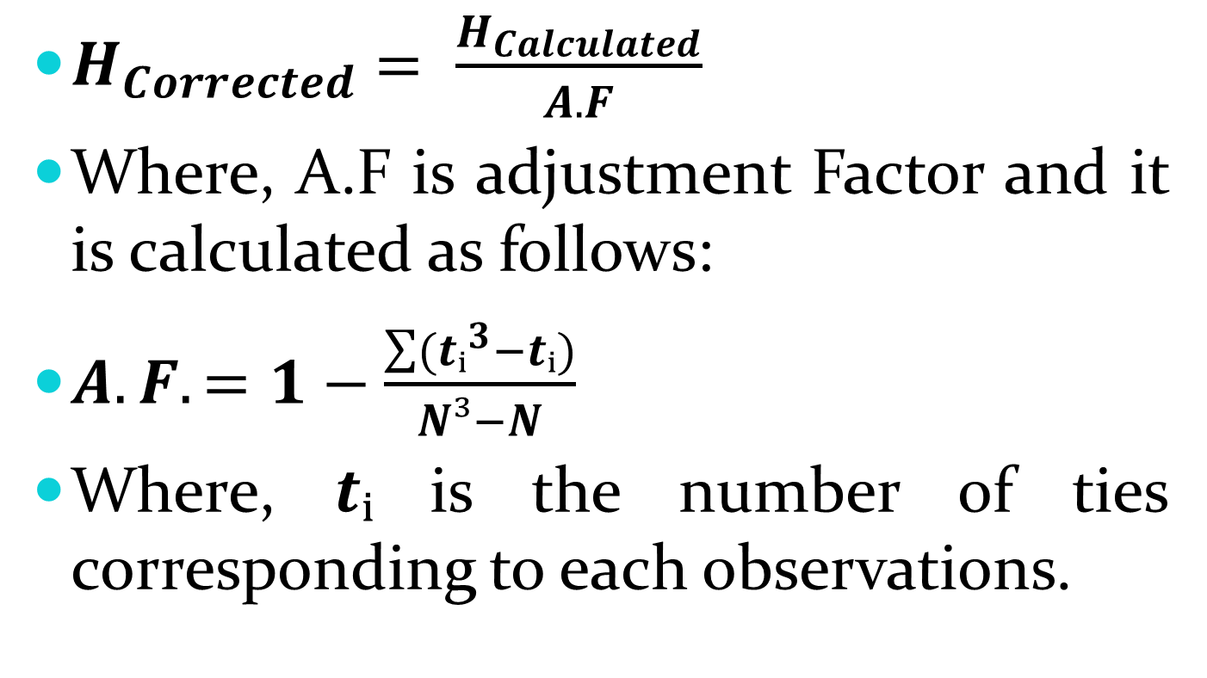
Test statistic for tied ranks:
$H_{Corrected}= \frac{H_{Calculated}}{A.F}$
Where, A.F is adjustment Factor and it is calculated as follows:
$A.F. =1−\frac{\sum{(tᵢ^{3}−tᵢ)}}{N³−N}$
Where, $tᵢ$is the number of ties corresponding to each observations.

Slide 6
Problems:
For the following scores of 3 groups, apply Kruskal Wallis H test to test the hypothesis that the three groups are not significantly different:
Group | Scores
A | 96 | 128 | 83 | 61 | 101
B | 82 | 124 | 132 | 135 | 109
C | 115 | 149 | 166 | 147

Slide 7
Problems:
A company’s trainees are randomly assigned to groups which are taught a certain industrial inspection produced by three different methods. At the instructing period they are tested for inspection performance quality. Following are their scores.
Determine at 0.05 level of significance whether the three methods are equally effective.
Method A | 68 | 80 | 83 | 79 | 85 | 90
Method B | 91 | 82 | 84 | 60 | 72 | 86 | 67
Method C | 88 | 93 | 65 | 77 | 78

Slide 8
Problems:
The following are the number of misprints counted on pages selected at random from three editions of book;
Use Kruskal Wallis H test at the 0.05 level of significance to test the null hypothesis that the samples come from identical population.
Edition I | 4 | 10 | 2 | 6 | 4 | 12
Edition II | 8 | 5 | 13 | 8 | 8 | 10
Edition III | 7 | 9 | 11 | 2 | 14 | 7

Slide 9
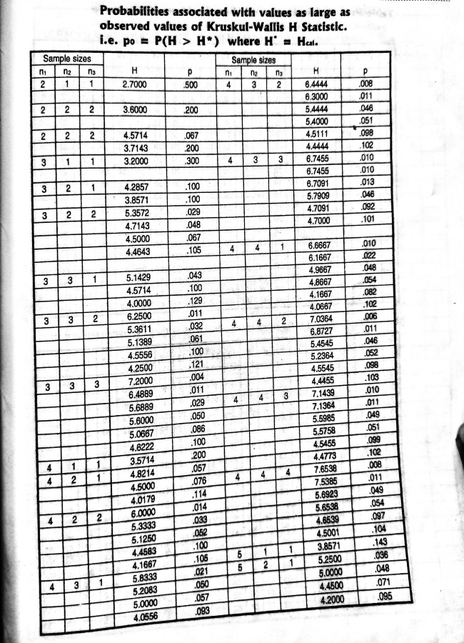

Slide 10
